Slide 1

Cohort: S24
Course name: Web Engineering
Professor: Clément ZIANE
https://www.datasciencetech.institute

Slide 2



API
Application Programming Interface

Slide 3
Definition
An application programming interface (API) is a connection between computers or between computer programs.
It is a type of software interface, offering a service to other pieces of software. Web APIs are a service accessed from client devices (Mobile Phones, Laptop, etc.) to a web server using the Hypertext Transfer Protocol (HTTP), JavaScript Object Notation (JSON) or Extensible Markup Language (XML) format
3

Slide 4
Rest API
The constraints of the REST architectural style affect the following architectural properties:[1][6]
performance in component interactions, which can be the dominant factor in user-perceived performance and network efficiency;
scalability allowing the support of large numbers of components and interactions among components;
simplicity of a uniform interface;
modifiability of components to meet changing needs (even while the application is running);
visibility of communication between components by service agents;
portability of components by moving program code with the data;
reliability in the resistance to failure at the system level in the presence of failures within components, connectors, or data.
4

Slide 5
How it works
HTTP Protocol
1 route per resource
Return a JSON or XML Data
5

Slide 6
Pros
Normalize the data
Data oriented approach
Communication standard
Scaling and flexibility
6

Slide 7
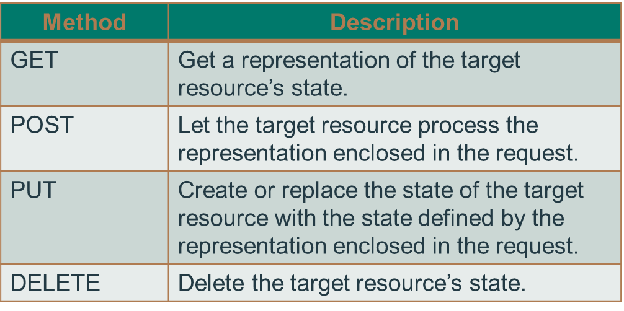
Semantics of HTTP Method
6

Slide 8
Build an API : Define our resources
Define each route to correspond to one resource. If we take Our Blog example :
Post : Represent a blog post
Comment : Represent a comment to a blog Post
Post
{
id : int,
title : string,
author : string
createad_at : DATE,
content : string
}
Comment
{
id : int,
post_id : int,
author : string
createad_at : DATE,
content : string
}
6

Slide 9
Build an API : Define our actions
Actions :
Retrieve all
Retrieve One
Create Post and Comment
Delete Post and Comment
Update Post
6

Slide 10
Build an API : Define our routes
Define each route to correspond to one resource. If we take Our Blog example :
[GET] /api/blog/posts retrieve all posts
[GET] /api/blog/posts/${id} retrieve a specific post
[GET] /api/blog/posts/${id}/comments retrieve all comments of one post
[GET] /api/blog/comments/${id} Get en specific Comment
[POST] /api/blog/posts Create a post
[POST] /api/blog/post/${id}/comments Create a comment to post ID
[PUT] /api/blog/posts/${id} Update a post
[DEL] /api/blog/posts/${id} delete a post
[DEL] /api/blog/comments/${id}
6

Slide 11
Swagger : How to Document an APi
Swagger is an Interface Description Language for describing RESTful APIs expressed using JSON. Swagger is used together with a set of open-source software tools to design, build, document, and use RESTful web services. Swagger includes automated documentation, code generation (into many programming languages), and test-case generation.
6

Slide 12
Questions ?
Ask them all !

